Slide 1
Contextualized Potential Drug-drug Interaction Clinical Decision Support Implementation Guide http://wiki.hl7.org/index.php?title=PDDI_CDS
May 12th 2018

Slide 2
Update on IG progress
Processes
Value sets
Questions
Goals for the fall Connectathon
IG team housekeeping

Slide 3
Processes
CDS Hooks Request and Response FHIR resources
Summary of operations

Slide 4
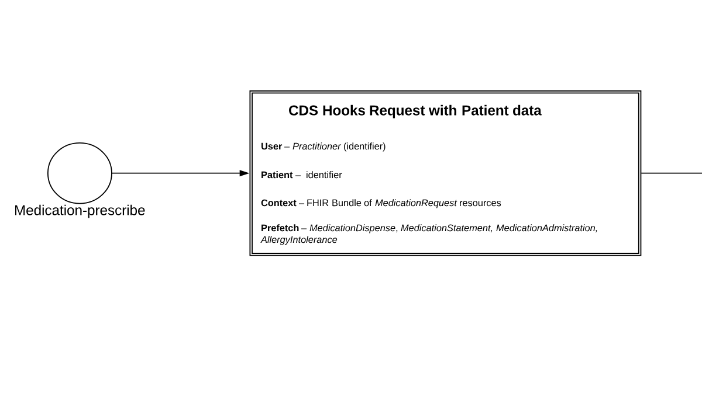
CDS Hooks Request and Response FHIR resources -1

Slide 5
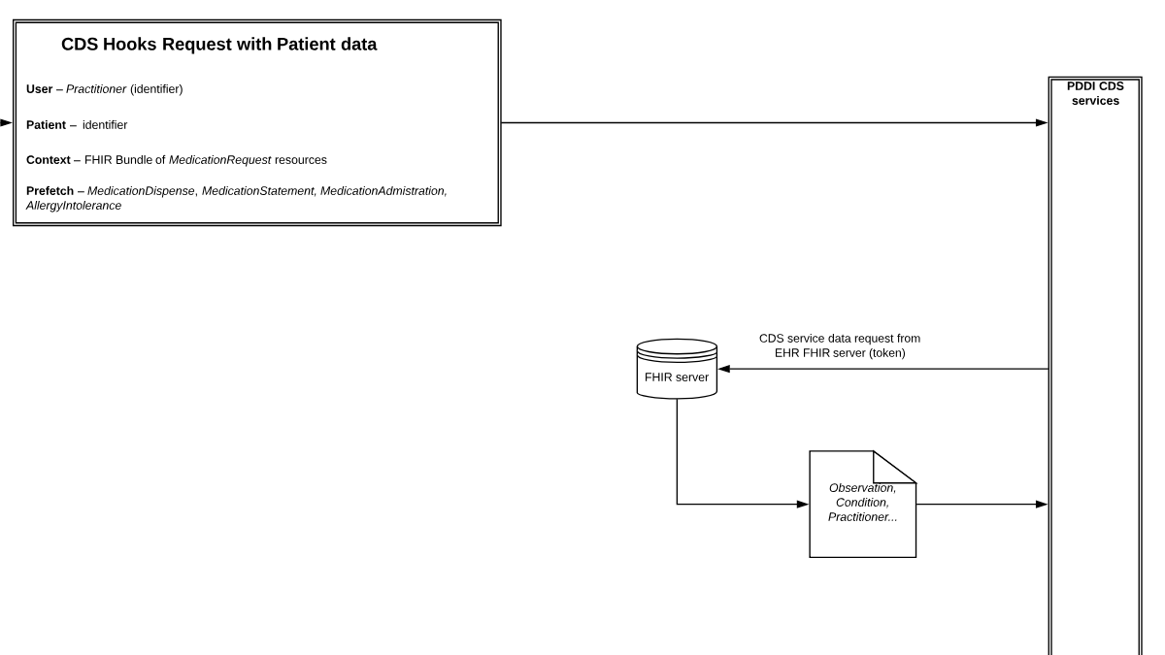
CDS Hooks Request and Response FHIR resources - 2

Slide 6
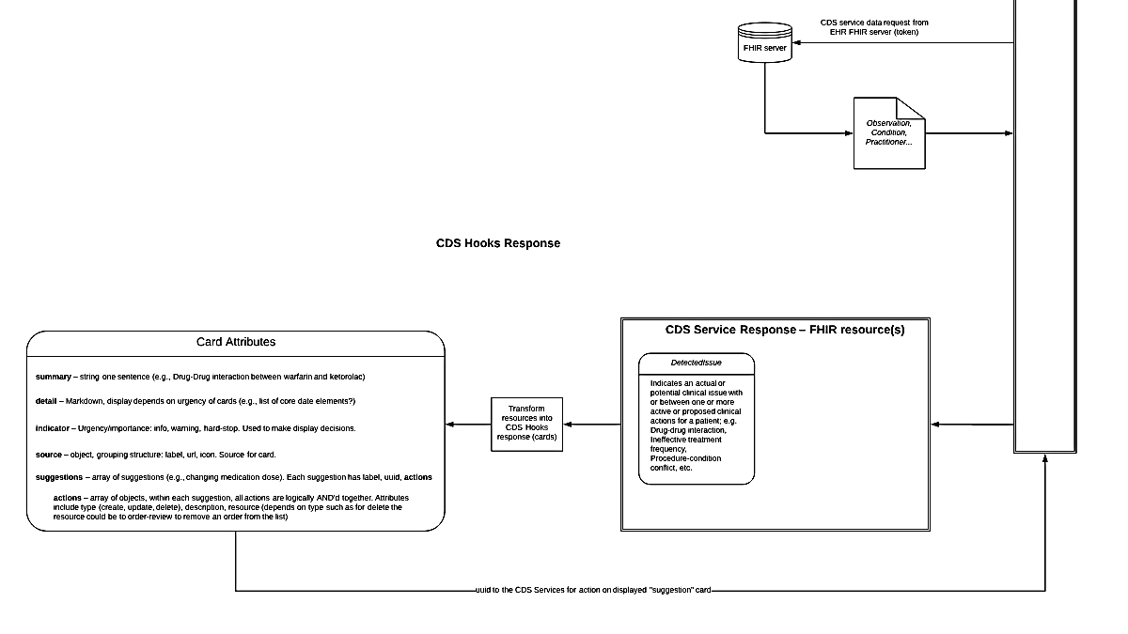
CDS Hooks Request and Response FHIR
resources - 3

Slide 7
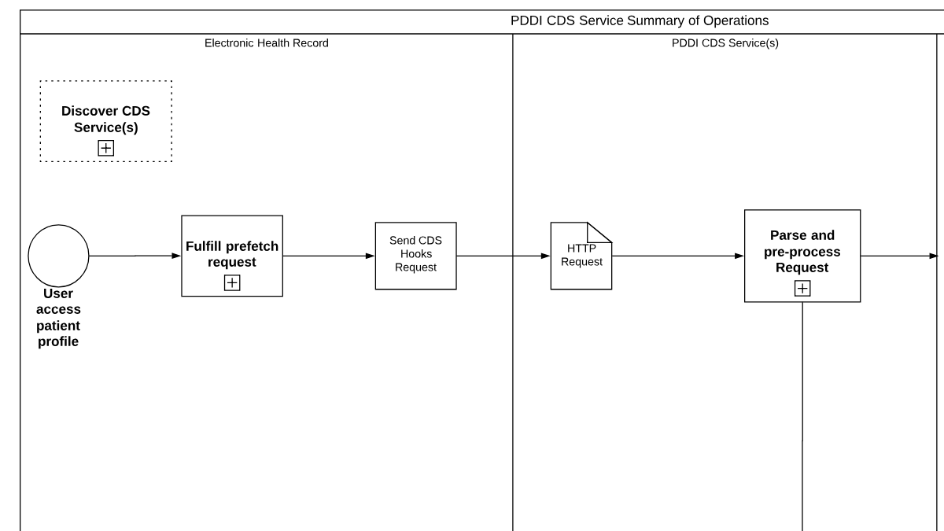

Summary of operations - 1
SMART
Authorization
and
Pre-request

Slide 8
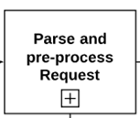
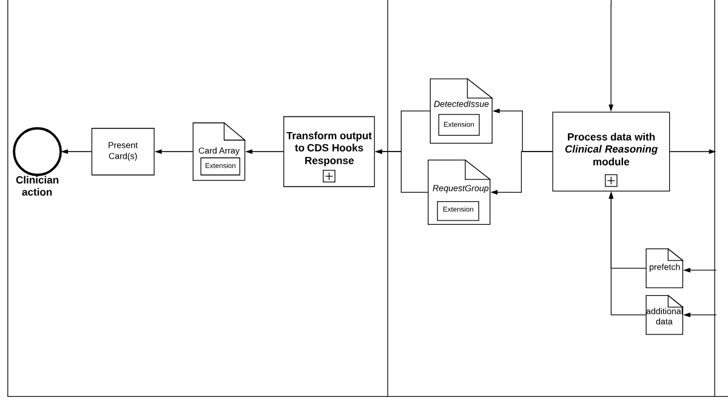
Summary of operations - 2
Electronic health record
PDDI CDS Services
Electronic health record
SMART
Authorization
and
Pre-request

Slide 9
Value sets
Requirements
Meet HL7 value set definition spec under ballot
PDDI-CDS IG is international in scope
Testing a solution
automation of an initial value set followed by manual removal of items that are not relevant
Terminology agnostic
Any extension we end up needed will be broadly applicable to CDS use cases

Slide 10
Goals for the fall Connectathon
Strike the right balance between pre-fetch templates vs on-demand request
Another 80/20 rule because most PDDI CDS can be done with the medication information
Using DetectedIssue in a CDS Hooks response
Expressive, maps well to the PDDI Min Info Model, and is storable in the client EHR system for downstream decision support
Value set solution including any new extension(s)

Slide 11
IG team housekeeping
HL7 Wiki: http://wiki.hl7.org/index.php?title=PDDI_CDS
Has all meeting info and github
Next two meeting : 5/16 and 5/30 at noon Eastern US

